Slide 1

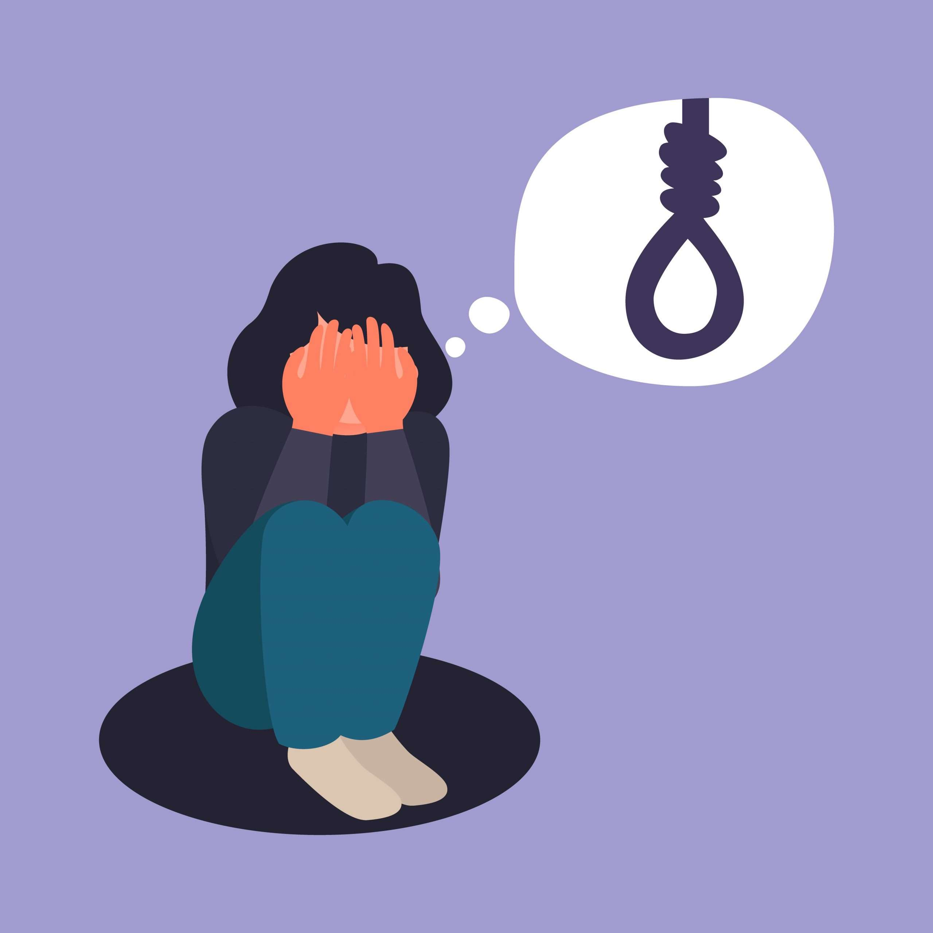
SUICIDE : A Sociological Study
Presenters:-
Aryan Bhardwaj 2021CE10511 Harshit Patel 2021ES10769
Devansh Gupta 2021CE10498 Pururaj Sisodiya 2021CE10486

Slide 2

What is Suicide?
Complex phenomenon
Influenced by social factors and not just psychological factors.

Slide 3

Durkheim’s Theory
What was Durkheim’s Theory?
Types of suicides according to Durkheim-
Egoistic suicide- Lack of integration to society
Altruistic suicide- Highly integrated to society
Anomic suicide- Sign of Failure
Fatalistic suicide- Over-regulated

Slide 4

Global Statistics
According to WHO, nearly 8,00,000 people die by suicide every year.
Second leading cause of death among 15-29 age group.
Low and middle income countries account for 79% of global suicides.
Higher rates among male construction workers, medical professionals, military veterans, farmers.

Slide 5

Warning Signs
Withdrawing from friends, family and society.
Sudden mood swings or changes in personality.
Talking about wanting to die or to kill oneself.
Feeling trapped or in unbearable pain.
Increased use of alcohol or drugs.

Slide 6

Suicide: A Sociological Perspective
Understanding social factors
Identifying patterns and trends
Developing effective prevention strategies
Challenging stigma

Slide 7

Farmers’ Suicide Statistics
Maharashtra - 3429 cases
Karnataka - 1484 cases
Andhra Pradesh - 1285 cases
Madhya Pradesh - 845 cases
Telangana - 585 cases
Indebtedness – 20.6%
Family Problems – 20.1%
Crop Failure – 17.2%
Illness – 13.2%
Drug Abuse – 4.4%

Slide 8

Major Reasons For Farmer Suicides
Indebtedness
Crop Failure
Lack of Government Support
Climate Change
Social Issues

Slide 9

Some Measures for Prevention
Government Policies and Interventions
Debt Relief Schemes
Crop Insurance
Subsidies & MSP
Rural Infrastructure Development
Role of NGOs and Civil Society
Awareness Campaigns
Financial Support
Mental Health Support

Slide 10

Sociological Aspects of Suicide
Absence of Social Integration
Lack of Social Support
Strictly Enforced Social Norms
Gender and Race/Ethnicity Parity

Slide 11

Closer Look at Female Suicide Statistics
Housewives - 22,623 (50.2%)
Self-employed - 4,772 (10.6%)
Farming/agriculture-related activities - 4,071 (9.0%)
Service (private) - 3,295 (7.3%)
Unemployed - 2,904 (6.4%)
Student - 2,787 (6.2%)
Service (government) - 1,840 (4.1%)
Others - 2,952 (6.5%)
Sikkim - 40.0 per 100,000
Andaman and Nicobar Islands - 24.3 per 100,000
Kerala - 23.4 per 100,000
Chhattisgarh - 20.9 per 100,000
Karnataka - 19.8 per 100,000

Slide 12

Major Factors Contributing to Female Suicide
Gender-based Violence
Mental Health Issues
Social and Economic Pressure
Cultural and Societal Expectations
Physical Health Issues

Slide 13
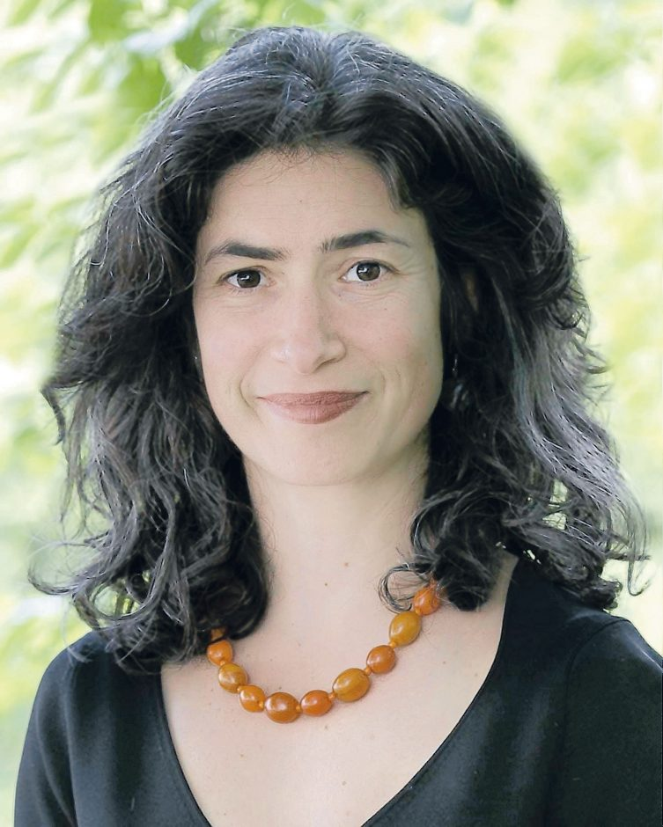
“Here One Day”(2012) by Kathy Leichter
Nina Leichter’s suicide
Battle with bipolar disorder and depression
Influential and well-off Background
Nuanced and Empathetic Portrayal of Mental Illness and Suicide

Slide 14

Role of Intersectionality
Acknowledgement of struggles due to intersecting identities
Multiple layers of oppression: Compounded Effects
Increased mental trauma and suicidal behaviour
Multifaceted support is required

Slide 15


Intersectionality overlap in female suicide rates
Women of color
LGBTQ+ women
Women with disability
Women from a low-income background
Tackling the intersecting factors

Slide 16

Potential solutions to the problem
Increasing awareness
Improving access to mental health care
Reducing stigma
Implementing suicide prevention programs
Addressing social and economic factors

Slide 17


What IITD is doing to address these problem
Mental health counselor
Awareness programs/ fests
Language mentorship
World mental health day
Extracurricular activities

Slide 18

CONCLUSION
Suicide is a serious issue that affects individuals and communities worldwide. It’s important to recognize the warning signs and risk factors associated with suicide and to take action to prevent it

Slide 19

Thank You

